Slide 1



Thrift Store with Interactive Web Application
Name – Asad Siddiqui
Mentor - Ms Ankita Nainwal

Slide 2

Overview of Thrift Stores
Purpose of Thrift Stores
Thrift stores serve to sell second-hand items at low prices, promoting sustainable consumption and recycling.
Social Impact
They benefit communities by providing affordable goods and supporting charitable causes, redistributing wealth where needed.
Environmental Benefits
Thrift stores help reduce waste by encouraging recycling and reusing items, contributing to environmental sustainability.

Slide 3
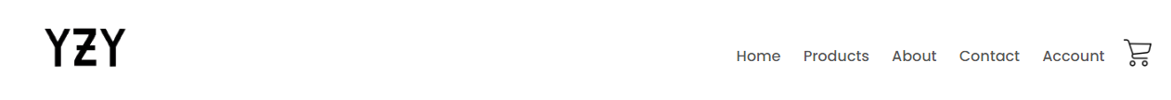
Web Interactivity
Engaging User Interfaces
Personalized Shopping Experience
Simplified Checkout
Interactive features like hover effects, animations, and dropdowns enhance user experience and drive engagement for your thrift store.
Easy-to-use forms and progress tracking make purchasing hassle-free for customers.
Implementing dynamic filters, search bars, and recommendation systems ensures a tailored experience, making it easier for users to find items.

Slide 4
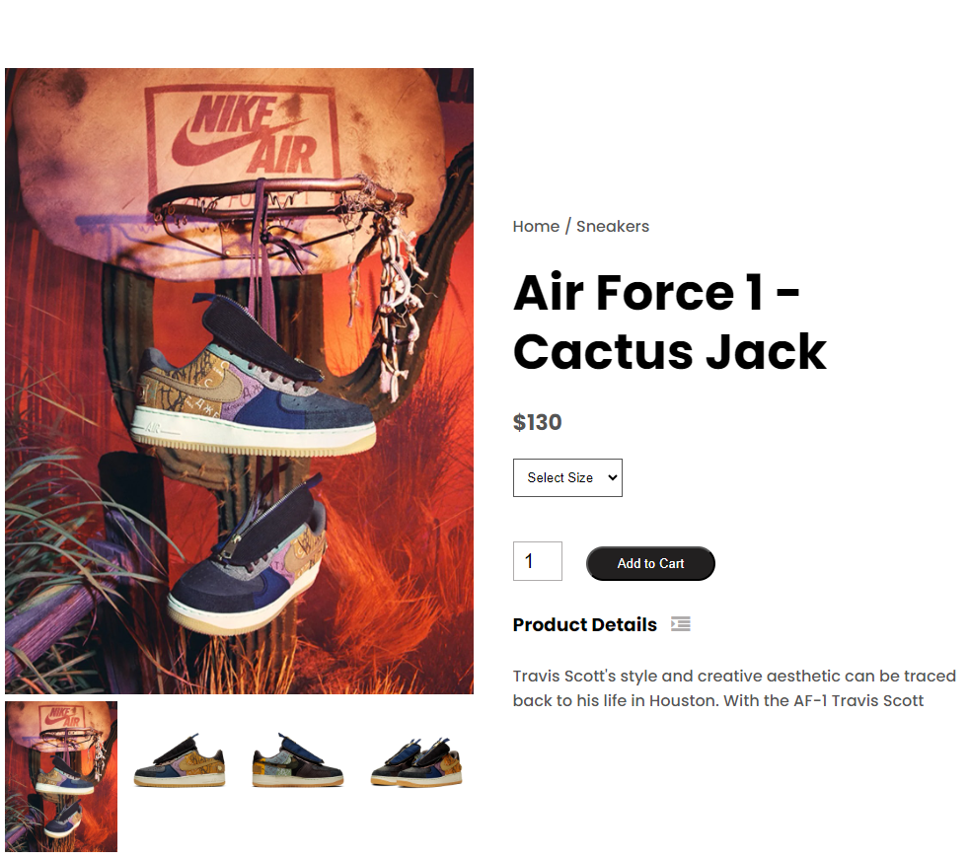
Methodology : HTML
Basic Structure
Use semantic tags for better SEO and accessibility. Ensure a clean, easy-to-follow document structure.
Forms and Inputs
Craft forms for purchases that are user-friendly, ensuring validation for a smooth user experience.
Responsive Design
Ensures your thrift store website adapts perfectly to all devices, enhancing user experience.

Slide 5
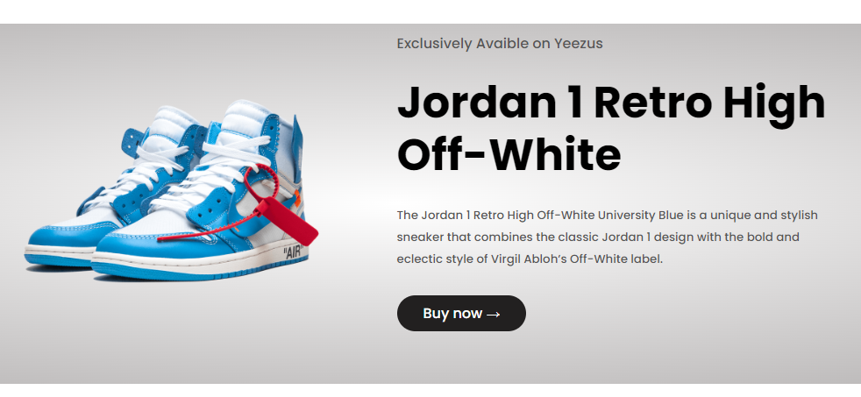
Methodology - CSS
Styling Principles
Layouts and Grids
Follow principles of accessibility and usability to enhance visual hierarchy and readability across all devices.
Employ CSS Grid and Flexbox layouts to create responsive and adaptable design features.
Animations and Transitions
Incorporate soft animations to enhance user interaction without overwhelming the user experience.

Slide 6
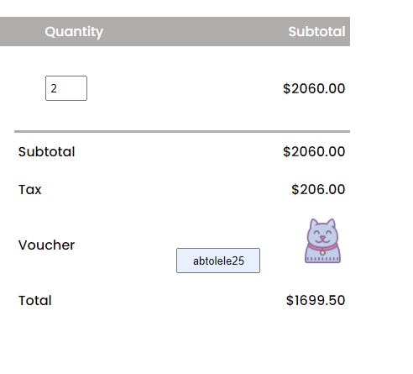
Methodology - JAVASCRIPT
Dynamic Elements
JavaScript enables dynamic elements like modals, dropdowns, and animations, making the thrift store interactive.
Data Handling
JavaScript processes and manages data, enabling real-time updates, seamless communication, and efficient user interactions.
User Interface Enhancements
Enhancing UI through animations, responsive design, and interactive components improves usability and customer satisfaction.

Slide 7
Results And Discussion
..
Checkout Efficiency
Assessing the ease and effectiveness of the simplified checkout process.
Responsiveness Performance
Evaluating the website's adaptability across various devices and screen sizes.
Data Handling Effectiveness
Measuring the reliability and speed of dynamic data processing and updates.

Slide 8
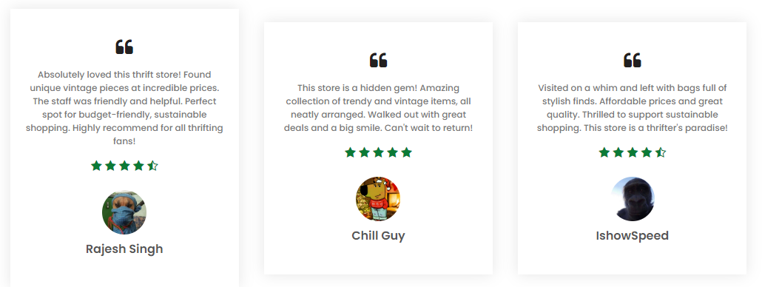
Results And Discussion
Collecting User Feedback
Revealed key insights to improve interactivity, user experience, and overall website functionality.

Slide 9

Conclusion And Future Work
Conclusion : The interactive thrift store website enhanced user engagement, simplified navigation, and streamlined shopping.
Future Work : Improving inventory management, adding personalized recommendations, and enhancing user interface for better shopping.

Slide 10



Thank You

